Slide 1
WEL COME

Slide 2
Engr. Masod Rana Instructor (Electronics) Technical School and College, Tangail.

Slide 3
GAIN ATTENTION.

Slide 4
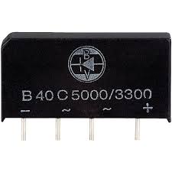
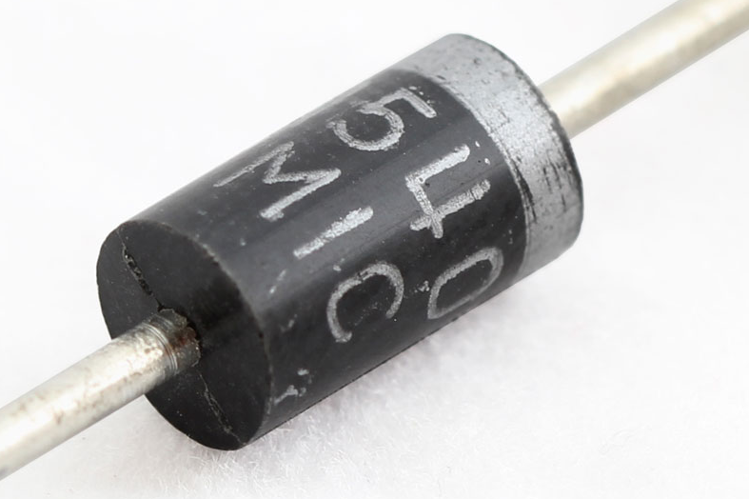
RECTIFIER

Slide 5
LEARNING OUT COMES. At the end of the lesson you should able to - 1. Describe working principle of Rectifier 2. Identify Rectifier Circuit . 3. Classify the Rectifier Circuit. 4. Explain the Rectifier Circuit.

Slide 6
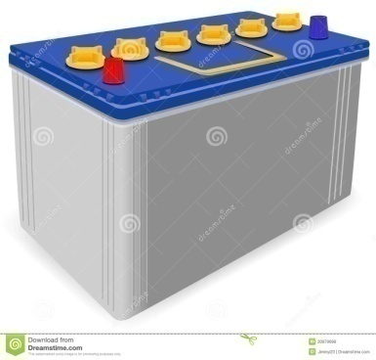
Recall of prior learning
Symble of diode
DC
Diode

Slide 7
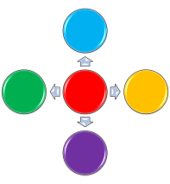
Rectifier diode
AC
DC

Slide 8
PRESENT THE CONTENT
Classification of rectifier
# Half wave rectifier
# Full wave rectifier
# Bridge rectifier

Slide 9
RECTIFIER CKT
Half wave
Full wave
Center trap Full wave
Bridge

Slide 10
Half wave Rectifier ckt
o/p wave
Rectifier
Load
Current Flow
Input

Slide 11
Full wave Rectifier
o/p wave
D 1
Input
Load
D 2

Slide 12
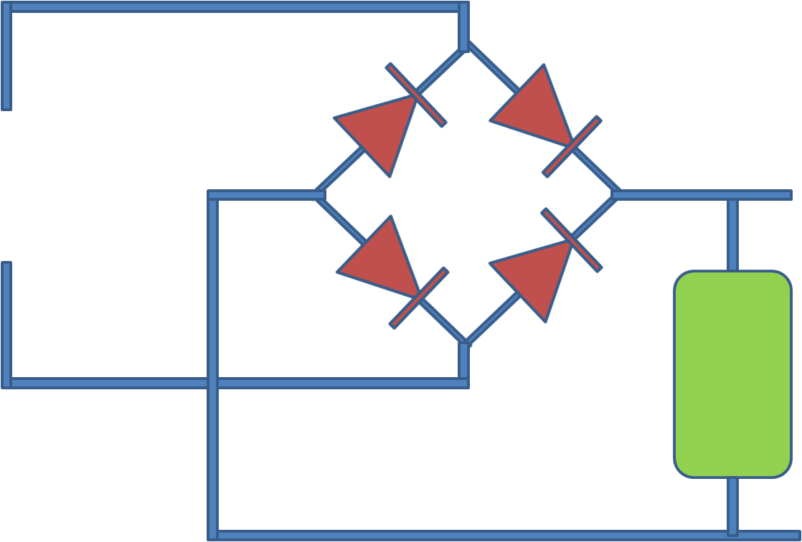
Bridge Rectifier
o/p wave
D4
D1
input
D3
D2
Load

Slide 13
VIDEO

Slide 14
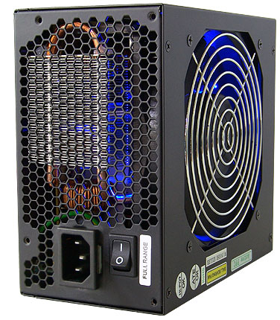
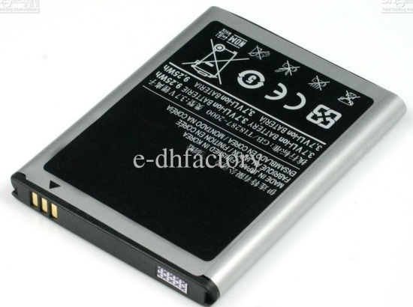
Provide learning guidance
Look at the picturs

Slide 15
Elicit performance
1. Write classification of rectifier
2. Draw half wave rectifier ckt
3. Draw full wave rectifier ckt
4. Draw bridge rectifier ckt

Slide 16
Provide feed back
1.How many diode are needed for half wave rectifier ?
2.How many diode are needed for full wave rectifier ?
3.How many diode are needed for bridge rectifier ?
4. What is difference between input and output of half wave rectifier ?
5. What is difference between input and output of full wave rectifier ?
4. What is difference between input and output of bridge rectifier ?

Slide 17
Assess performance

Slide 18
A
K
A
K
Simble of diode
Diode
Bridge rectifier

Slide 19
Enhance relation and transfer
Now you make a group by five students and discus with each other 5 min.

Slide 20
THANK YOU

